Slide 1
JEWS in ŠEduva
ŠEDUVA GIMNASIUM

Slide 2
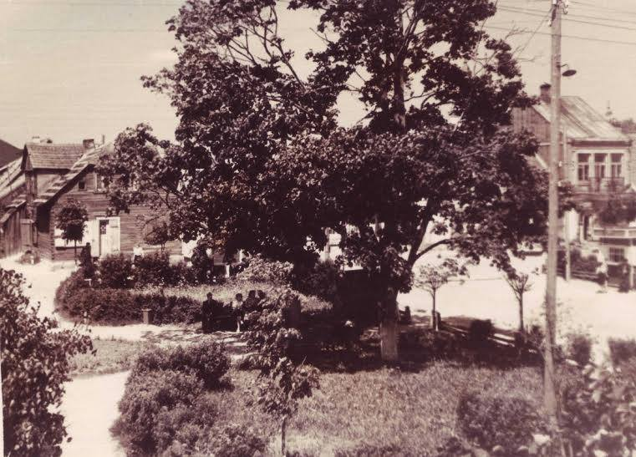
EARLY HISTORY IN ŠEDUVA
As early as the 8th century Jews lived in many parts of the Lithuanian territory.

Slide 3
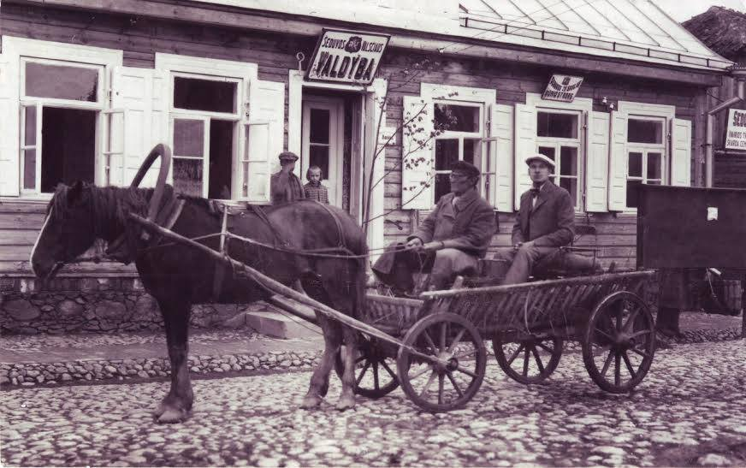
POPULATION
In Šeduva Jews made up 61,2 percent of the population

Slide 4
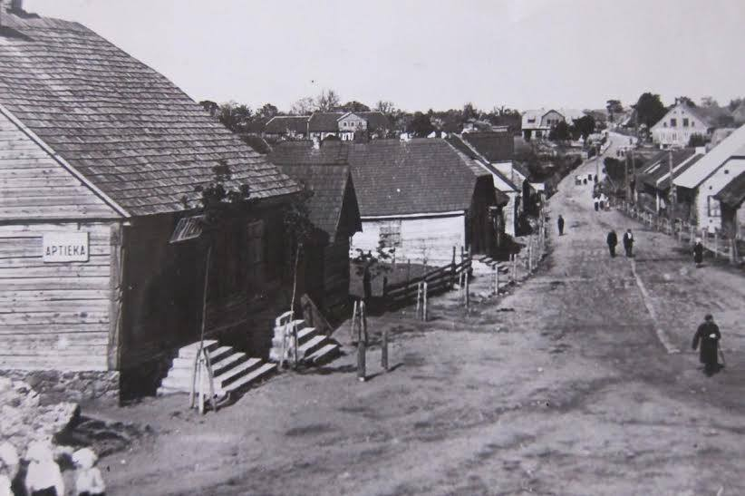
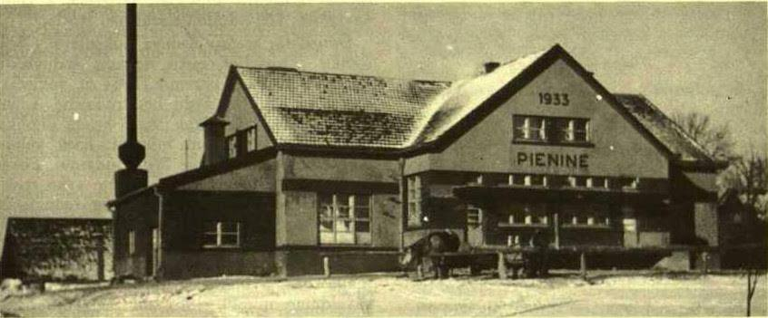
ACTIVITY
Jews influenced basicly all the life spheres of Šeduva

Slide 5
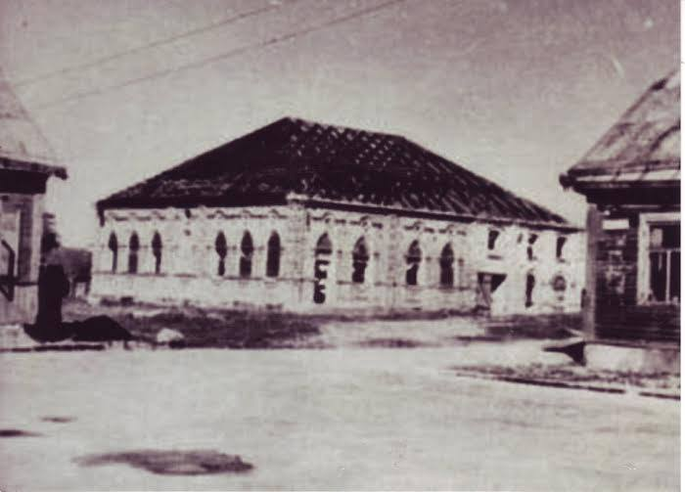
Jews in Šeduva had four synagogues, windmill, many shops, restaurants, lemonade shop, bakery, bank and even their own school.

Slide 6
TRADITIONS
Like all Jews Šeduva Jewish inhabitants followed their traditions.

Slide 7
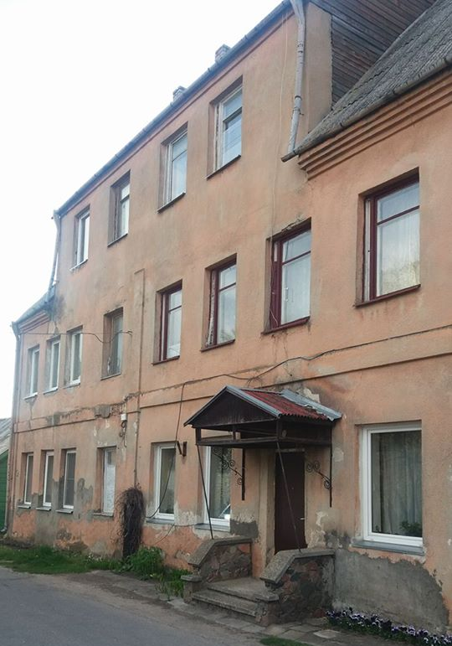
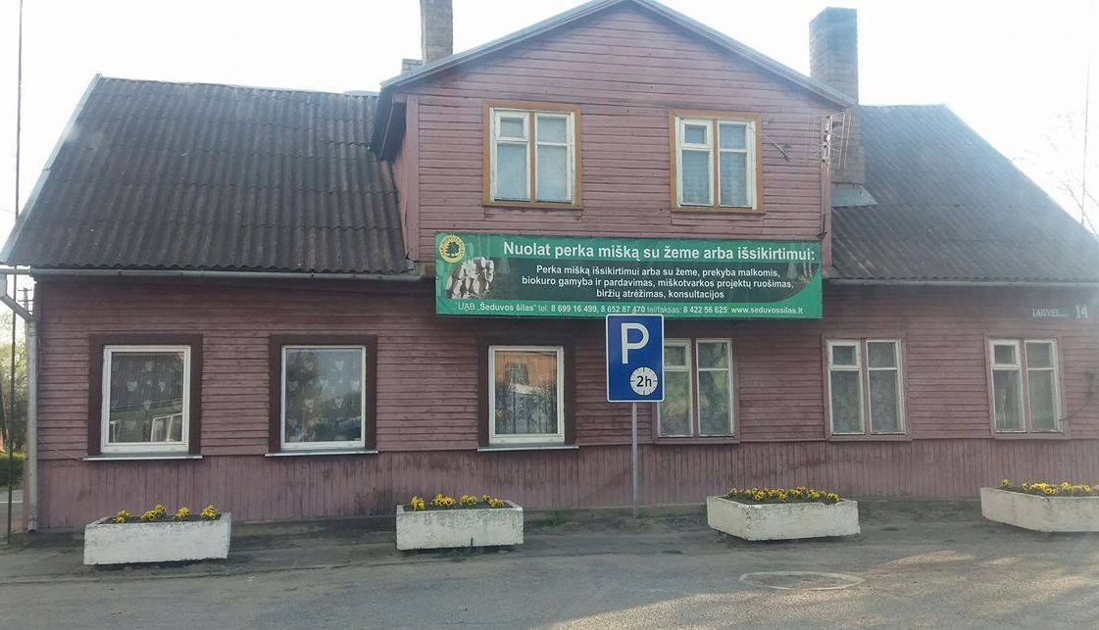
HERITAGE
Most of buildings in Šeduva were built by Jews people. Some of them still stand.

Slide 8
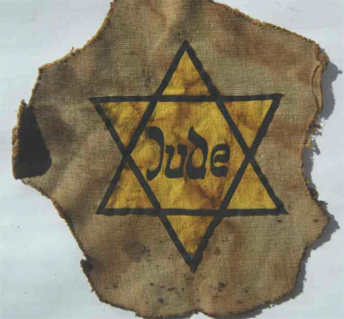
The Second World War and the Holocaust
The biggest disaster of the Jewish people was the German occupation and the genocide which took place in.

Slide 9
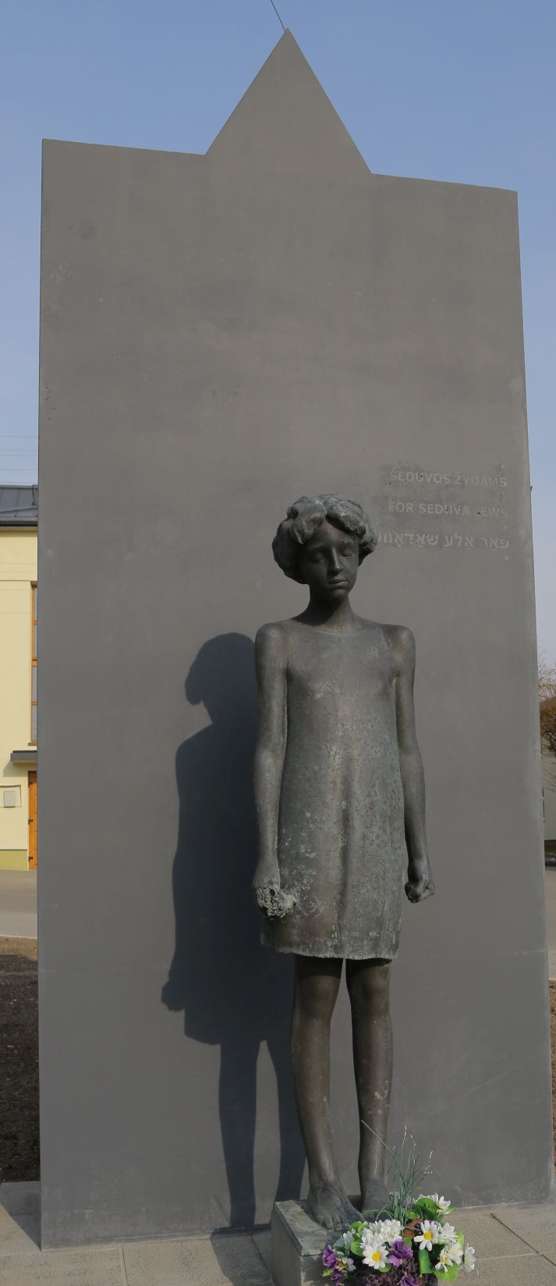
In order to honour Holocaust victims sculpture ‘’Lost Shetl” was built in the town center
MEMORIAL

Slide 10
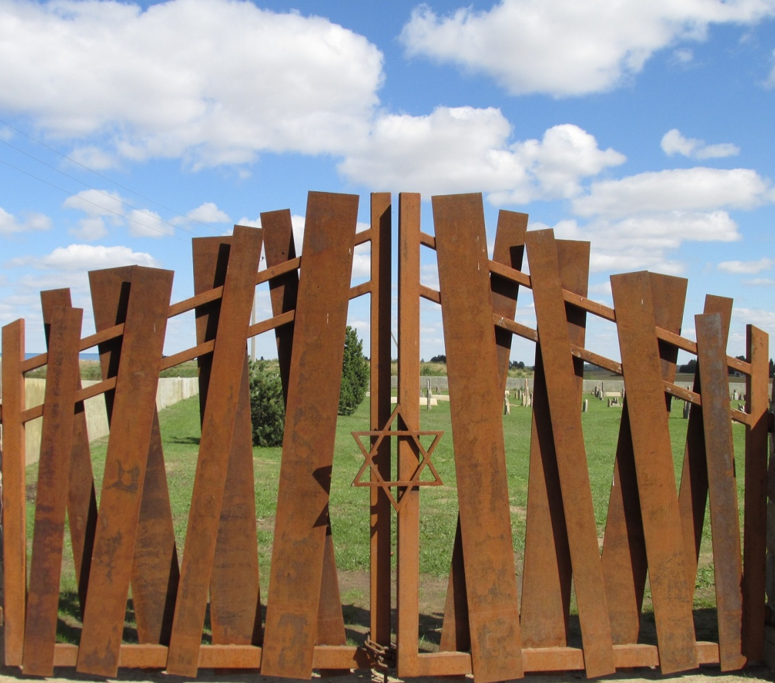
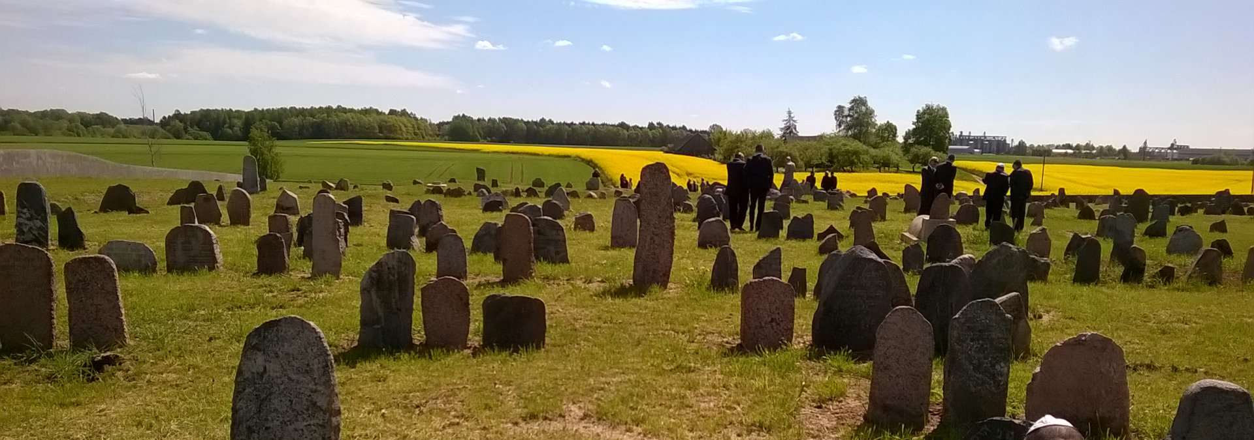
Today an ancient Jewish cemetery reminds us the large Jewish community .

Slide 11
THANK YOU FOR
YOUR ATTENTION

